Slide 1

CREDIT RISK INSIGHTS ANALYSIS
Data-Driven Intelligence for Strategic Decisioning

Slide 2

RISK BASELINE ANALYSIS
UNDERSTANDING THE Data
8%
The 8% Target ratio represents our core Risk baseline. Any feature deviating significantly from this 8% "danger zone" line is identified as a critical driver of creditworthiness.
TARGET Baseline
•
Focus on high-variance categorical features.
•
Numerical thresholding against default probability.

Slide 3

CREDIT DEFAULT DATA CLEANING
Data Cleaning & Feature Engineering Strategy

Slide 4
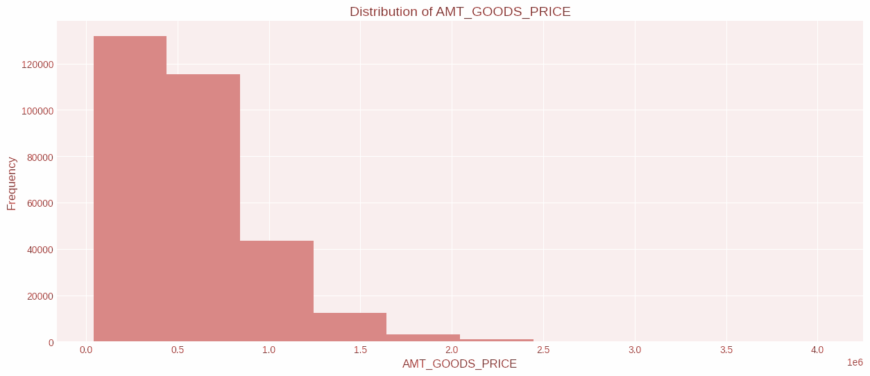
1. FINANCIAL OUTLIER STRATEGY
Income & Assets Capping
Extreme financial values create skewness that disrupts model.
Income: Capped at 800K (Top 0.1%).
Goods Price: Capped at 2M (Top 0.3%).
Log Transform: Applied to normalize Income distribution.

Slide 5




2. DEMOGRAPHIC CONSISTENCY
Family Members
Gender Imputation
Result
Observations with 5+ members showed a significantly higher default risk (17%). Capped at 5 to maintain statistical relevance while capturing the risk signal.
Detected null values in the gender column. Applied Mode Imputation (Female) to preserve dataset size without introducing bias.
Standardized household features ready for one-hot encoding or ranking.

Slide 6

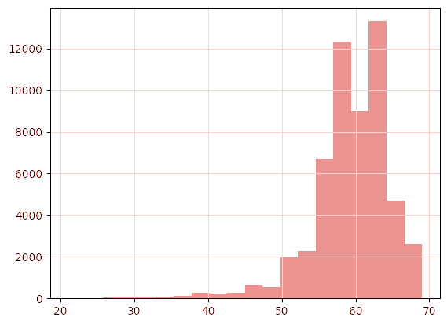
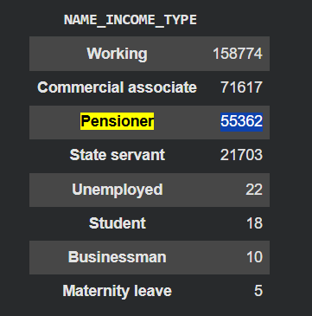
3. RESOLVING WORK HISTORY
The Employed YEARS
The Correction
Detected 55,000 entries with impossible "Days Employed" SO deal as “Nulls”
Step A: Replace Nulls with time values.
Step B: Set Occupation to "Unemployed" for these segments.
look for them in OCCUPATION_TYPE was same “Nulls”
look for them in INCOME_TYPE All common to the "Pensioner" income type.
so I changed OCCUPATION_TYPE to unemployed.
so I changed Days Employed to 27 YEAR. [Median - Search]

Slide 7
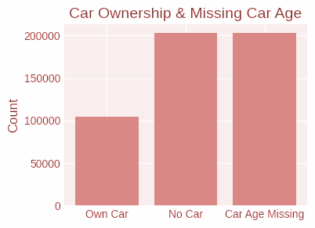
4. OWNERSHIP & CAR AGE
Logical Imputation
Car Age nulls matched the 'Flag Own Car' = 0 perfectly.
Null Fix: Replaced with 0 years.
Capping: Clipped at 23 years.
Impact: Only 3% of users owned cars +23 years.

Slide 8



5. TEMPORAL FEATURE ENGINEERING
Converted raw 'Days' features into 'Years' to enhance interpretability and reduce model noise.
Age
ID Publish
Registration
Work History
Days Birth
Days ID
Days Reg
Days Employed
Result: 5 Columns Dropped | 5 New "Year" Features Created

Slide 9
6. SPARSE FEATURE AGGREGATION
A. Individual Document Flags Some document flags show high risk. ( Document 2 → 31% default — Document 21 → 14% default ) However, the sample size is extremely small (13 and 100 customers) B. Aggregation Strategy all document flags were aggregated into a single feature representing the total number of submitted documents.
C. Final Feature Design Most customers submitted only one document (~270K), while very few submitted more than one (~7K, ~2.5%).
Therefore, the feature was simplified into a binary variable: 0 = no documents submitted, 1 = one or more documents submitted

Slide 10
8. MISSING DATA PROTOCOL
Null Threshold | Strategy Applied | Predictive Signal Check
> 60% | Dropped Feature | High Sparsity / Low Information Gain
30% - 60% | Importance Evaluation | Impute Median if critical, else Drop
< 30% | Median Imputation | Impute Median
*Missing data flags were created for features where the absence of data suggested higher credit risk.

Slide 11

FINAL DATASET STATE
Ready for Prediction
From 121 raw variables down to a refined set of predictive features. All noise points identified by the task have been addressed through logical imputation and statistical capping.
Outliers Controlled
Logical Consistency Restored
Multicollinearity Removed
Nulls Cleaned

Slide 12
PART 1: CATEGORICAL INSIGHTS
Analyzing Demographic & Qualitative Features

Slide 13






CRITICAL INCOME & OCCUPATION RISK
MATERNITY LEAVE
UNEMPLOYED
LOW-SKILL LABOR
40%
36%
17%
The single highest risk factor in income classification.
Critical danger zone requiring maximum focus.
Significant default elevation compared to baseline.

Slide 14
CRITICAL INCOME & OCCUPATION RISK
MATERNITY LEAVE
UNEMPLOYED
LOW-SKILL LABOR
40%
36%
17%
The single highest risk factor in income classification.
Critical danger zone requiring maximum focus.
Significant default elevation compared to baseline.

Slide 15
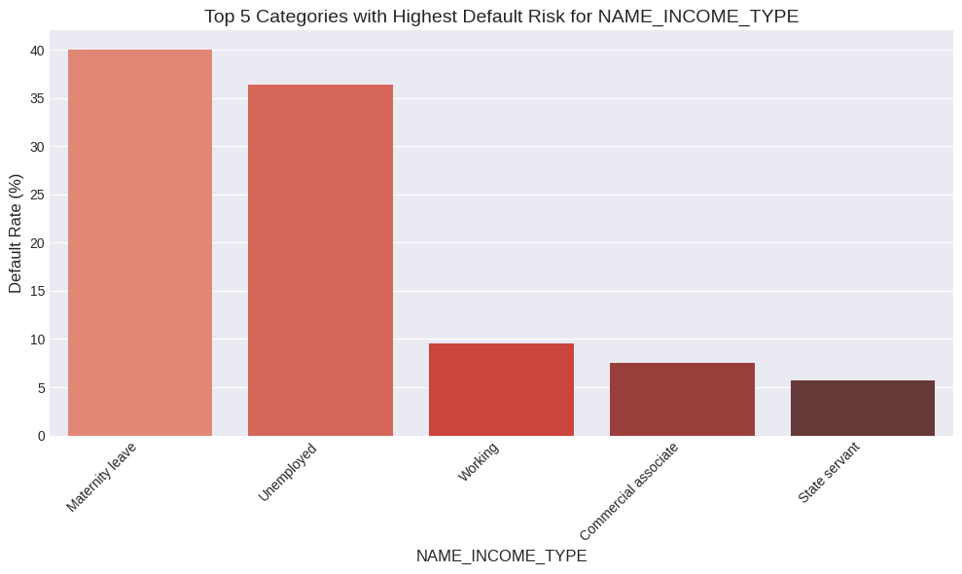

HIGH SKILL PROFESSIONAL STABILITY
SAFETY CLUSTERS
Higher cognitive and technical skilled roles demonstrate resilience and extremely low risk profiles (3% - 5%).
Managers & Accountants
IT & High Skill Tech Staff
Pensioners

Slide 16
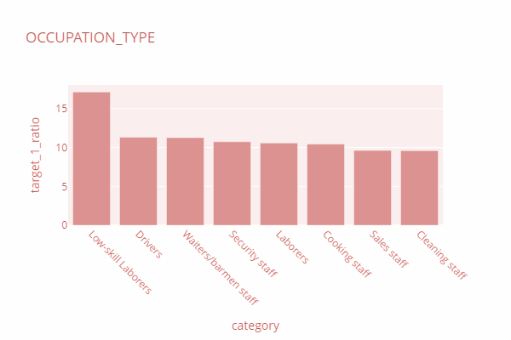

HIGH SKILL PROFESSIONAL STABILITY
SAFETY CLUSTERS
Higher cognitive and technical skilled roles demonstrate resilience and extremely low riskprofiles (3% - 5%).
Managers & Accountants
IT & High Skill Tech Staff
Pensioners

Slide 17
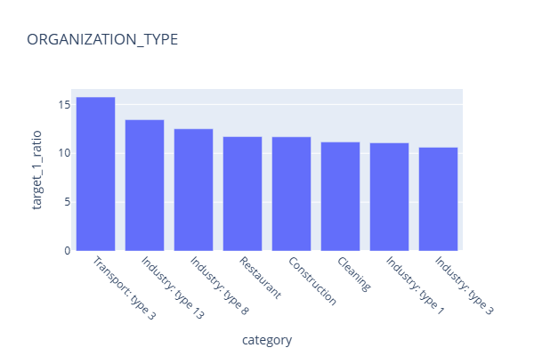
ORGANIZATION SECTOR HOTSPOTS
Categories exceeding 10% target ratio threshold:
Organization Category | Action
Transport (Type 3) | HIGH Risk
Industry (Types 8 & 13) | MORE Review Required
Restaurant / Construction | Manual Review Required
Cleaning Services | Verification Required

Slide 18


HOUSING TYPE & LIVING STATUS
HOUSING RISK
HOUSING MODE
Renters and those living with parents show an elevated risk of 12%.
Specific Housing: 10% Risk
12%
Terraced House: 8.5% Risk

Slide 19
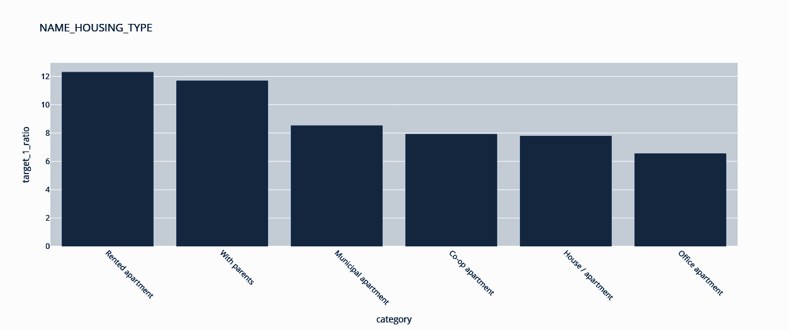
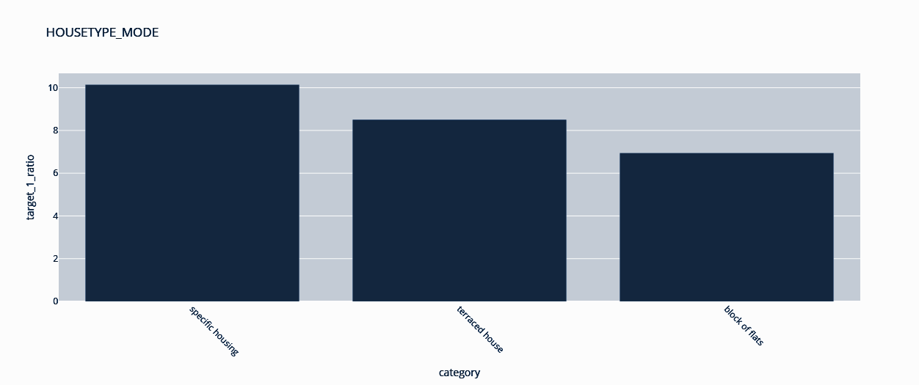
HOUSING TYPE & LIVING STATUS
HOUSING RISK
HOUSING MODE

Slide 20
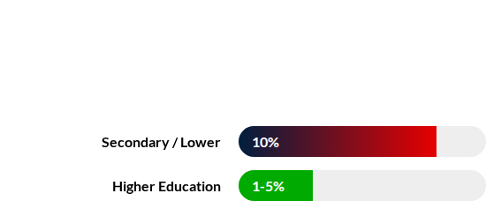
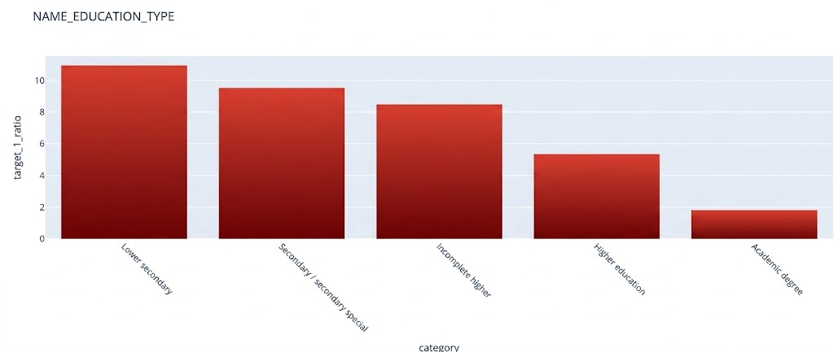
EDUCATION AS A RISK BUFFER
THE KNOWLEDGE STABILITY
General Insight: The higher the client's level of education, the lower the risk.

Slide 21
EDUCATION AS A RISK BUFFER

Slide 22
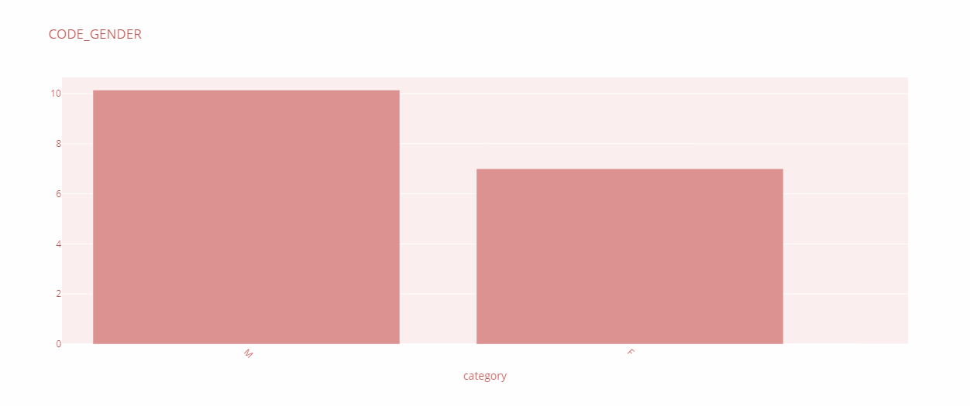
GENDER-BASED RISK DISPARITY
Male: 10% Risk
Female: 7% Risk

Slide 23
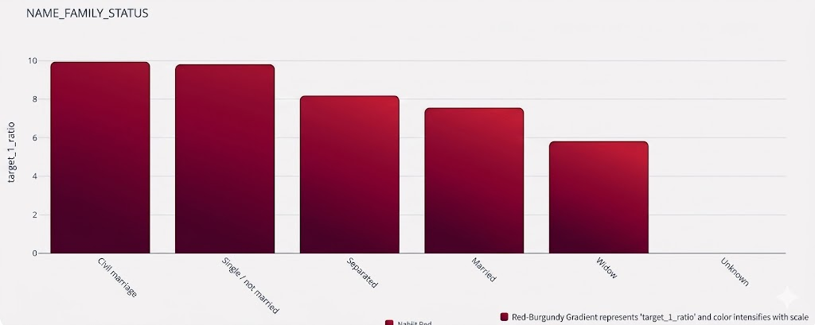




FAMILY STATUS STABILITY TRENDS
TOP 3 CATEGORIES IMPACTING TARGET
Civil Marriage
Single / Unmarried
Separated
9.94%
9.81%
8.19%

Slide 24
FAMILY STATUS STABILITY TRENDS
TOP 3 CATEGORIES IMPACTING TARGET
Civil Marriage
Single / Unmarried
Separated
9.94%
9.81%
8.19%

Slide 25
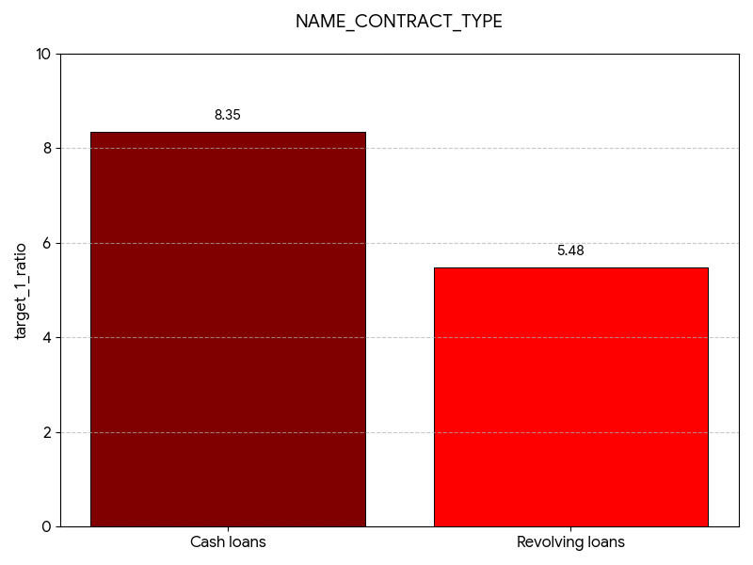
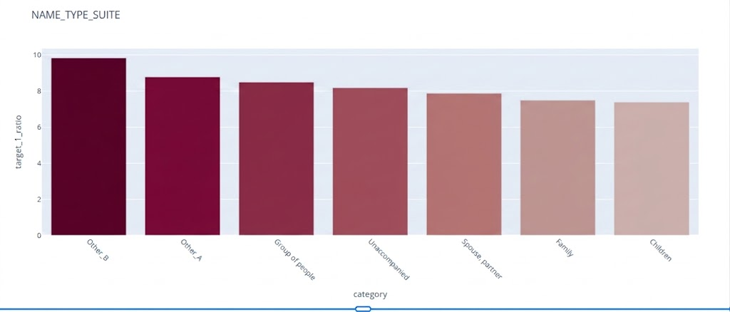

CONTRACT & SUITE INFLUENCE
CONTRACT INSIGHTS
SUITE INSIGHTS
Cash Loans (8.35%) carry significantly higher risk than Revolving Loans (5.48%).
Other_B: 9.83%
Other_A: 8.78%
Group of People: 8.49%

Slide 26
CONTRACT & SUITE INFLUENCE
SUITE INSIGHTS
CONTRACT INSIGHTS
Cash Loans (8.35%) carry significantly higher risk than Revolving Loans (5.48%).
Other_B: 9.83%
Other_A: 8.78%
Group of People: 8.49%

Slide 27


ASSET OWNERSHIP (FLAG_OWN)
SECURITY INDICATORS
"Generally, whenever a person owns property or a car, this is a superior indicator of financial security."

Slide 28



ASSET OWNERSHIP (FLAG_OWN)

Slide 29
PART 2: NUMERICAL INSIGHTS
Analyzing Continuous & Quantitative Metrics

Slide 30
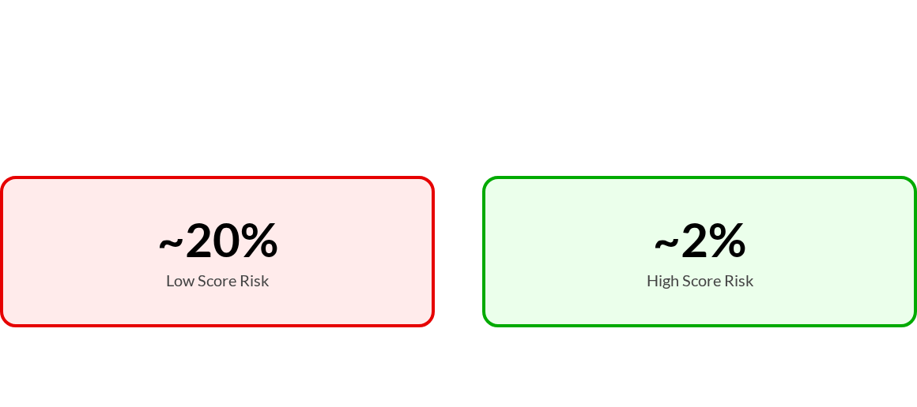
THE STRONGEST PREDICTORS (EXT)
EXT_SOURCE_1, 2, 3
These external scores are the dataset's strongest risk predictors.

Slide 31

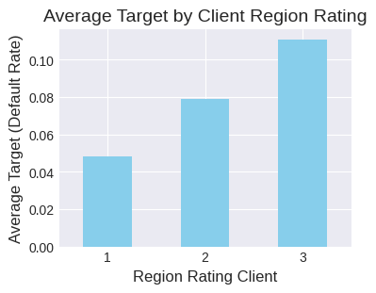
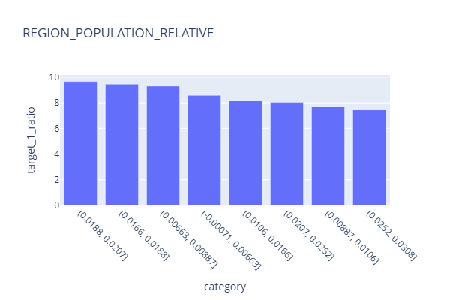
REGIONAL SAFETY RATINGS
REGION RATING CLIENT
POPULATION RELATIVE
Higher-rated regions are inherently linked to safer clients.
Low Pop (0.01-1%): 9.6% Risk
•
High Rating (2.0-3.0): 11.1% Risk
High Pop (1.5-3%): 4.5% Risk
•
Low Rating (1.0-2.0): 7.51% Risk

Slide 32
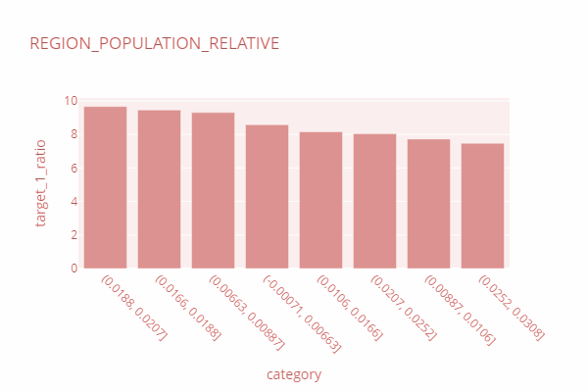
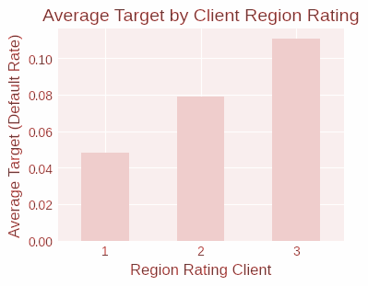
REGIONAL SAFETY RATINGS
REGION RATING CLIENT
POPULATION RELATIVE
•
•
High Rating (2.0-3.0): 11.1% Risk
Low Pop (.01-1%): 9.6% Risk
Low Rating (1.0-2.0): 7.51% Risk
High Pop (1.5-3%): 4.5% Risk

Slide 33

LOAN SIZE VS REPAYMENT CAPACITY
AMT_CREDIT
AMT_ANNUITY
Loans in 300K - 600K range exhibit higher relative risk.
Risk peaks in the mid-range (25K - 32K).
~10%
~10%
Higher annuity ranges (>32K) drop to ~5.8% risk.

Slide 34
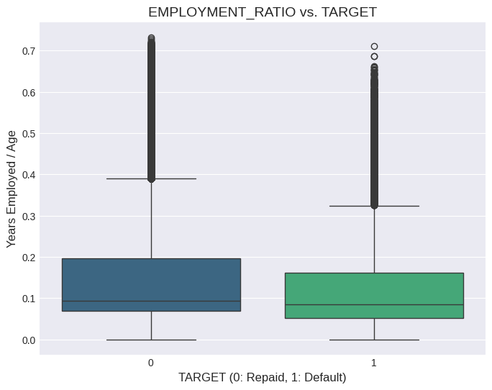
CLIENT STABILITY MARKERS
High Risk
Low Risk
< 5 YEARS
> 20 YEARS
ID Publish & Registration
Stable Identity History
9.7% - 10% Default
5.0% - 5.6% Default
Employment Ratio Impact: Low experience indicates a higher risk level across all segments.

Slide 35
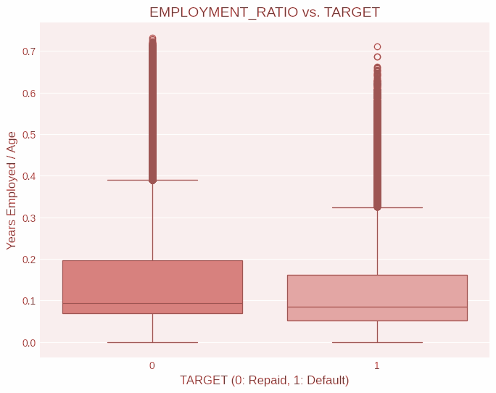
CLIENT STABILITY MARKERS
Low Risk
High Risk
Employment Ratio Impact: Low experience indicates a higher risk level across all segments.

Slide 36
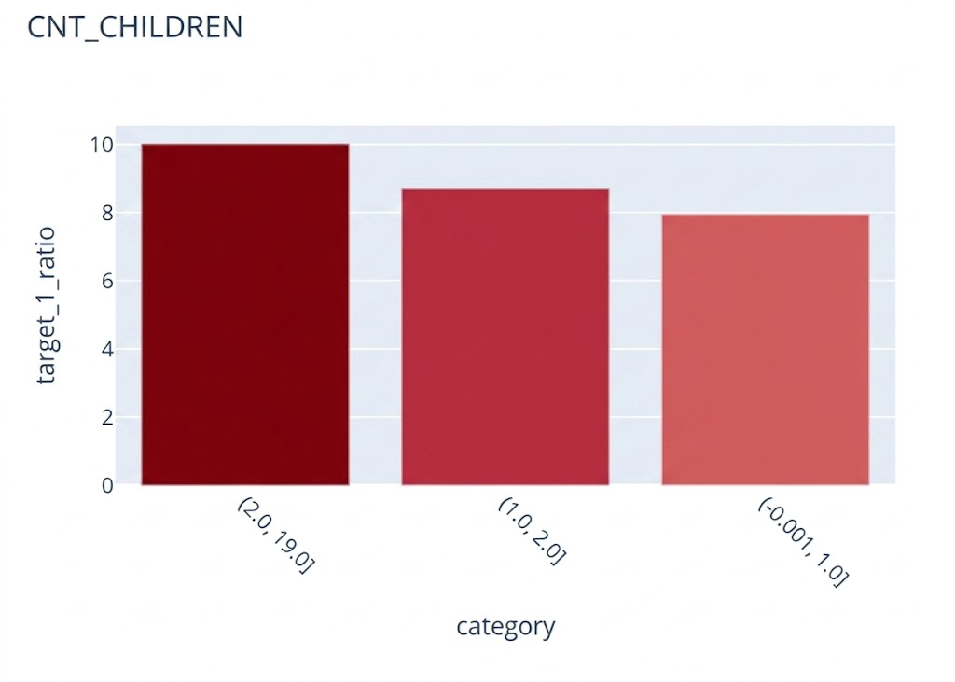

HOUSEHOLD & FAMILY DYNAMICS
KEY HOUSEHOLD INSIGHTS
•
2-4 Children: ~10% Default risk.
•
0-1 Children: Safer profiles (<8%).
Correlative Note: Larger family size (>3) often correlates with decreased average income, spiking risk from 8% to 12%.

Slide 37
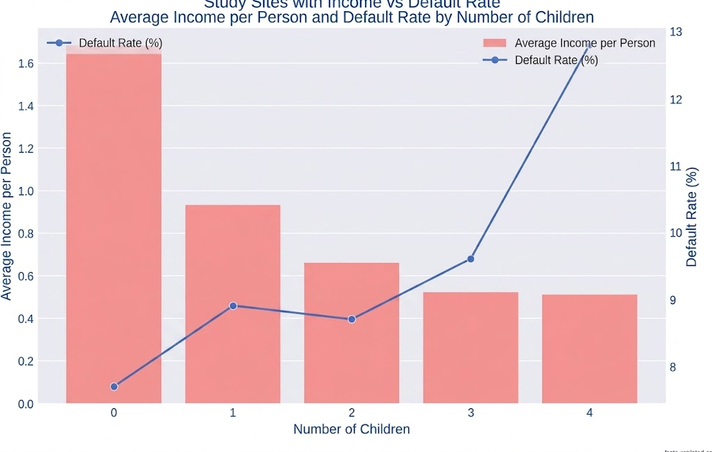
HOUSEHOLD & FAMILY DYNAMICS
KEY HOUSEHOLD INSIGHTS
Correlative Note: Larger family size (>3) often correlates with decreased average income, spiking risk from 8% to 12%.
•
•

Slide 38
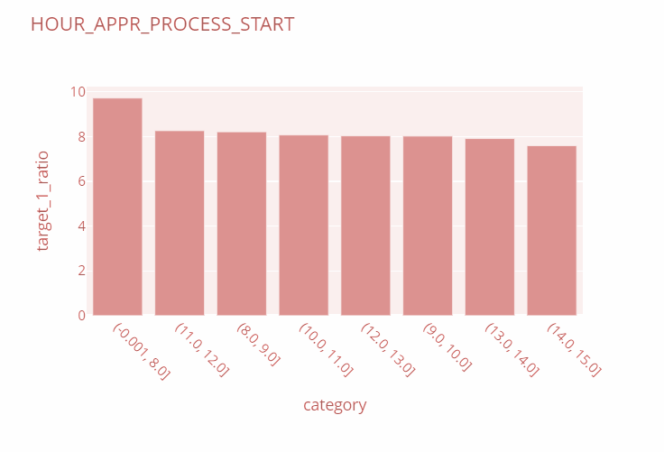
TEMPORAL RISK: HOUR OF START
HOURLY APPLICATION TRENDS
Applications initiated in the early hours show a distinct risk profile.
Before 8 AM: 9.7% Risk
Late Hours: 6.7% Risk
Default risk steadily decreases throughout the business day.

Slide 39



LIVING CONDITIONS & MOBILITY
OWN_CAR_AGE
LIVINGAREA_AVG
FLOORSMAX
Old Cars (17+ yrs): 9%+
Small Area (<0.03): 9.2%
Few Floors (<0.1): 9.2%
New Cars (2-7 yrs): 5-6%
Large Area (0.08+): 5.5%
High Rise: 4.9%

Slide 40
ATTACHED
Risk_Report
num_analysis
cat_analysis
A report explaining the importance of each feature;.
Sheet of the most important Numerical factors affecting the risk ratio, and its categories sorted from most important to least important.
Sheet of the most important categorical factors affecting the risk ratio, and its categories sorted from most important to least important.

